Slide 1
KnowItAll
Daniel Makover
Kun Mo
Gunnar Nichols
Heli Kolambekar
Haoyi Zhu
Yuwei Wu
Weiye Xu

Slide 2
Presentation Content
INTRODUCTION
REQUIREMENT ANALYSIS
DEMONSTRATION
DESIGN AND FEATURES
IMPLEMENTATION AND TECHNICAL STACK
REFACTORING AND ALGORITHMS
TESTING
SECURITY
CONFIGURATION MANAGEMENT
DEPLOYMENT
GROUP AND RISK MANAGEMENT
FUTURE SCOPE

Slide 3
Introduction
Group Members:
Kun Mo - Group Leader
Daniel Makover - Backup Group Leader
Gunnar Nichols - Quality Assurance
Heli Kolambekar - Requirements
Haoyi Zhu - Design and Implementation
Yuwei Wu - Security
Weiye Xu - Configuration
What is Knowitall?
An innovative and interactive trivia web app where players can test their knowledge across hundreds of questions from a variety of topics.

Slide 4
REQUIREMENT ANALYSIS
ESSENTIAL FEATURES
USER AUTHENTICATION
CATEGORIES
TRIVIA GAME WITH 3 LIVES
DESIRABLE FEATURES
LEADERBOARD
IN-GAME LIFELINES
PLAYER PROFILE
OPTIONAL FEATURES
PASSWORD RESET AND VERIFICATION
SUPERUSER FUNCTIONS
CHANGE USERNAME, EMAIL AND PASSWORD

Slide 5
DEMO

Slide 6
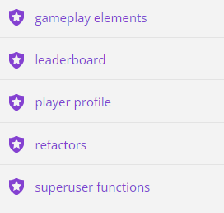
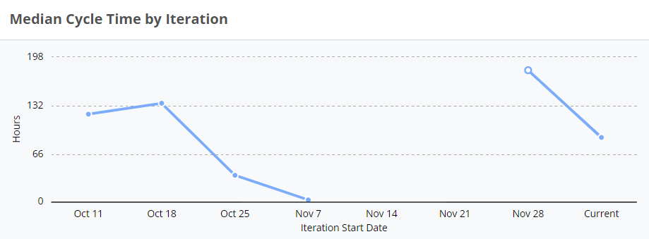
PIVOTAL TRACKER TOOL
PROJECT EPICS

Slide 7
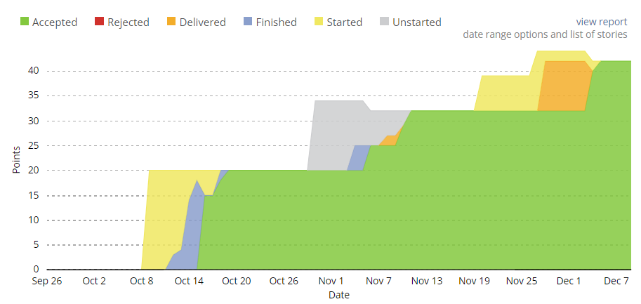
CUMULATIVE FLOW

Slide 8
REQUIREMENT CHANGES
1
MULTIPLAYER FEATURE
LEADERBOARDS BY CATEGORY
2
RESTORE GAME SESSION
RESET PASSWORD VIA EMAIL AUTHENTICATION
3
EXTENDED TIME LIFELINE
SUPERUSER FUNCTIONS TO MODIFY QUESTIONS
HANDLING REQUIREMENT CHANGES
OPTIMIZING USER EXPERIENCE
PRIORITIZING ESSENTIAL FEATURES
HOW THE PROPOSED CHANGES AFFECT THE CURRENT CODE

Slide 9
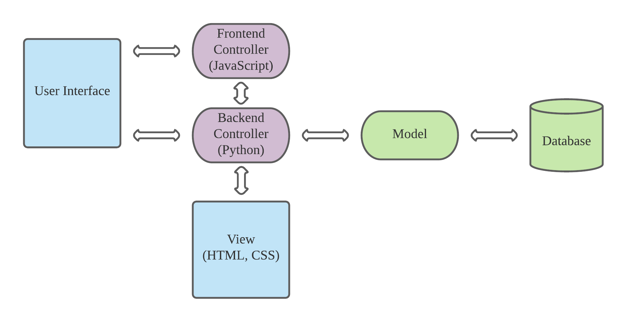
Design
Architecture: MVC
Framework: Flask
Database:
Development: SQLite
Production: PostgreSQL

Slide 10
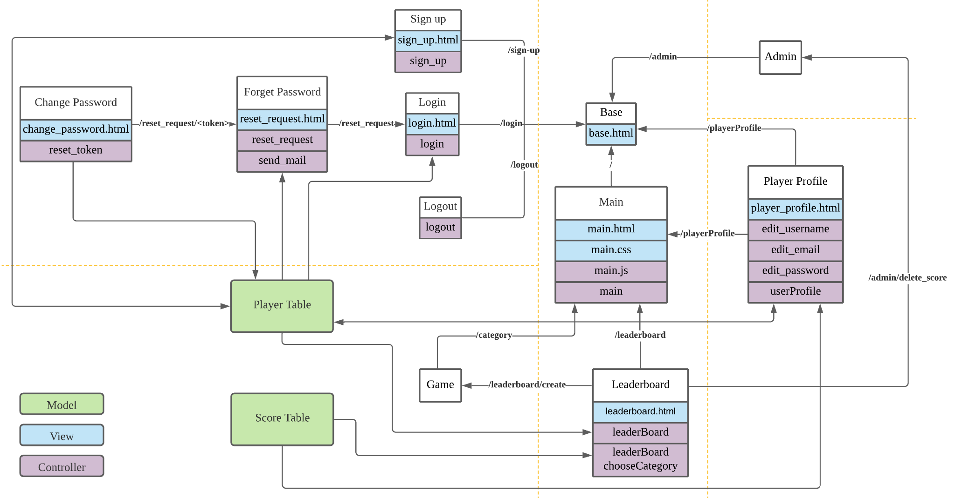
Player Features
view.py
admin.py
auth.py
game.py
player_profile.py

Slide 11
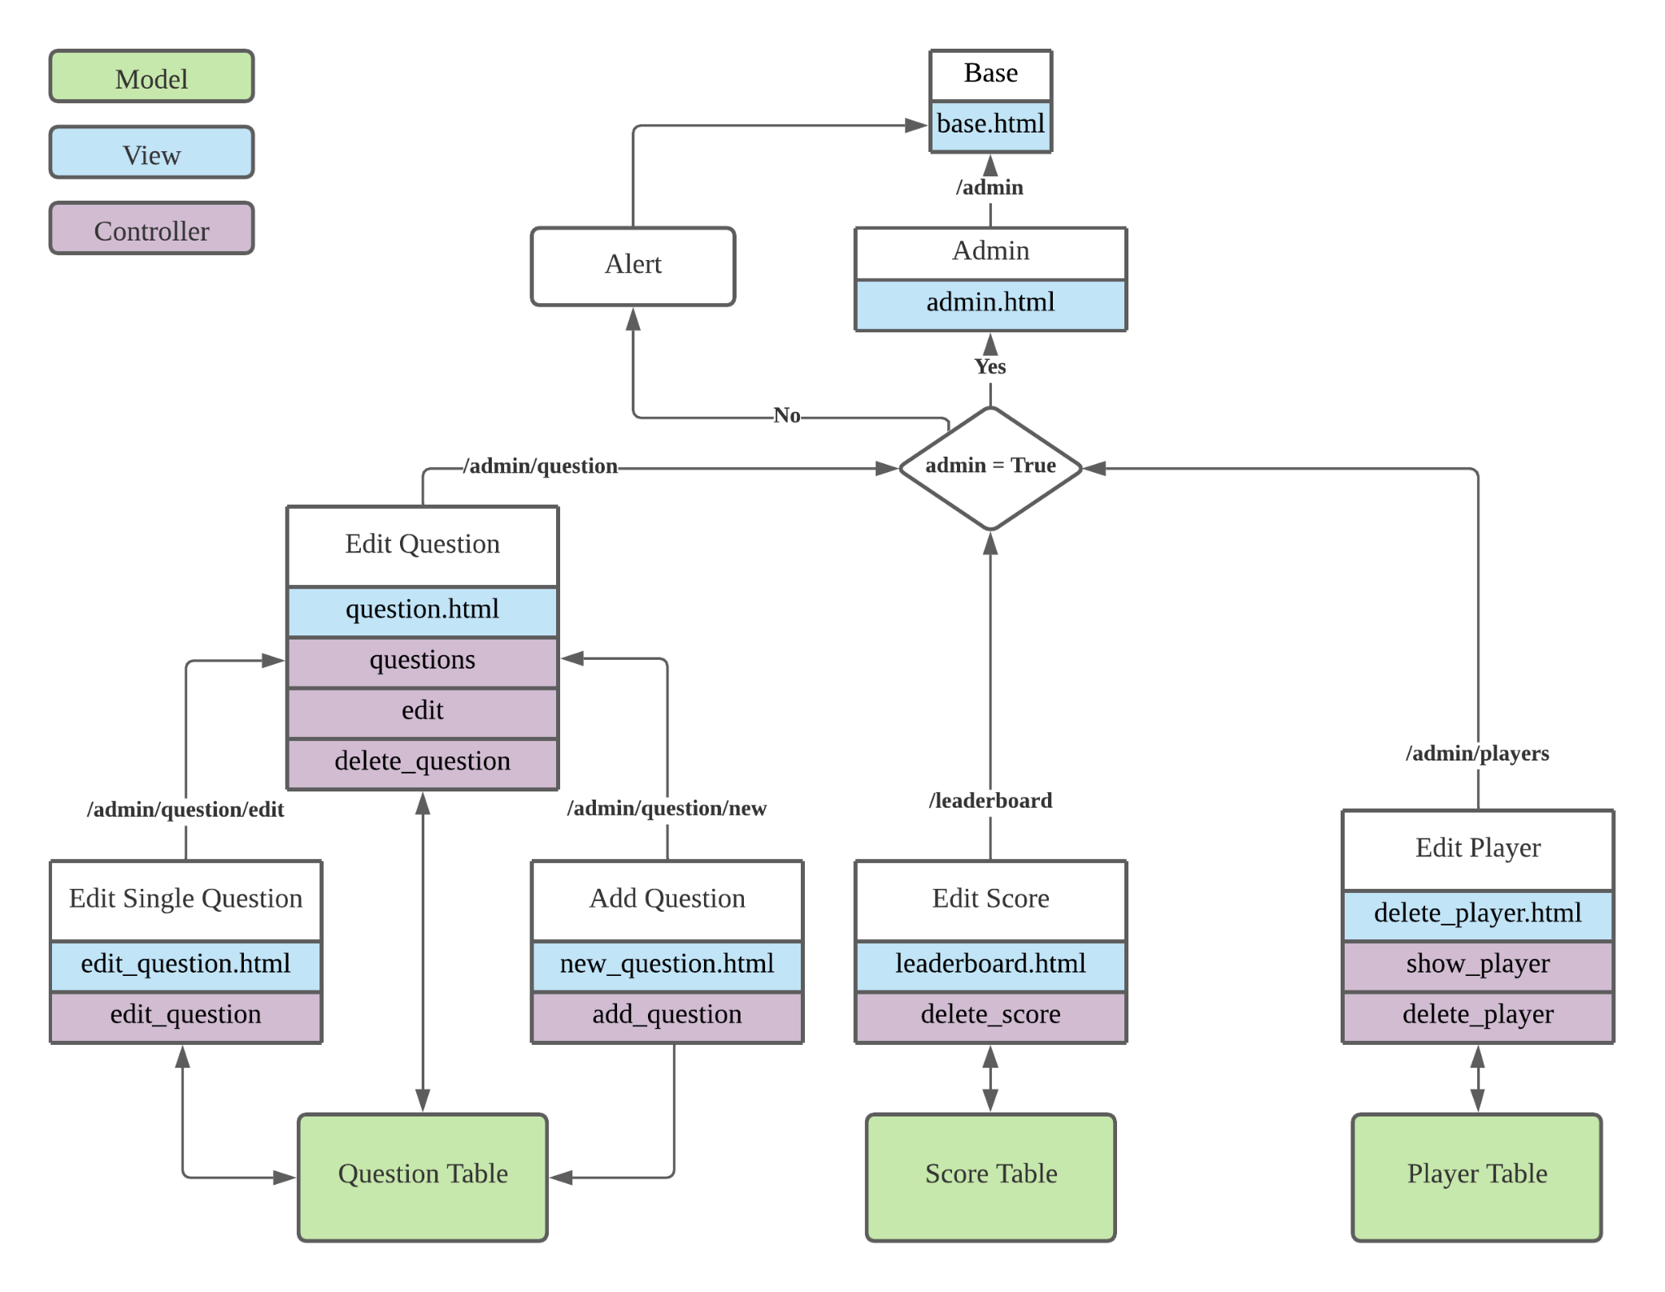
Admin Features

Slide 12
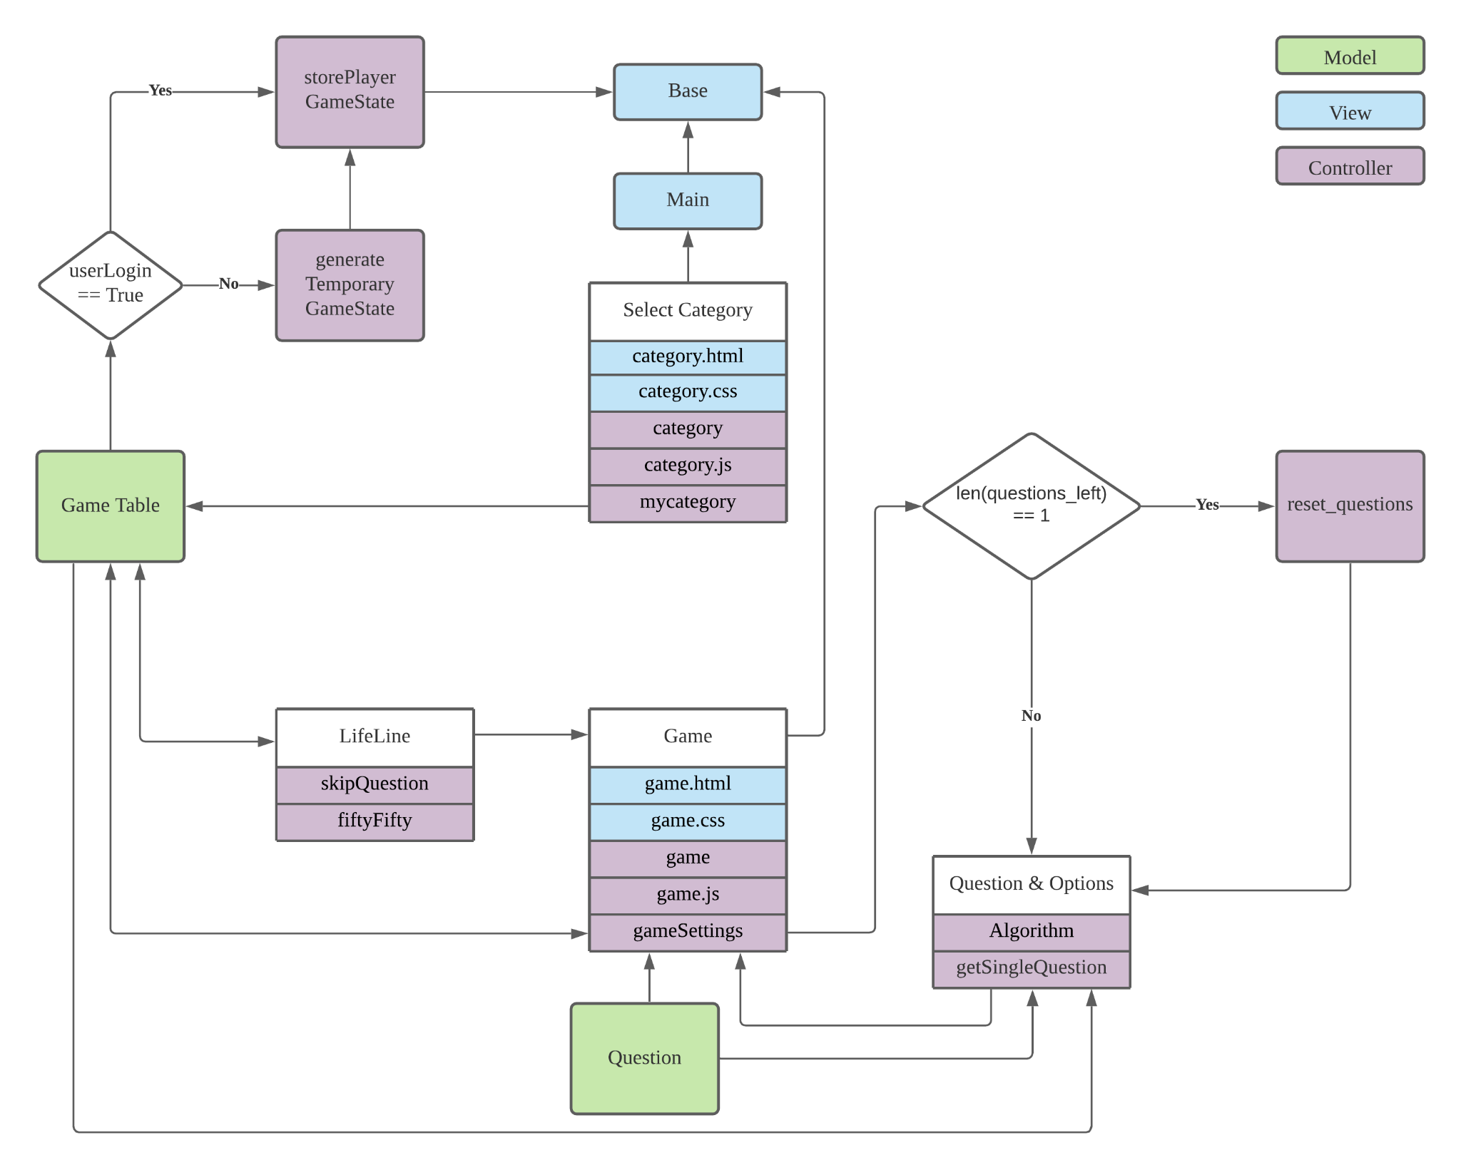
Game Features

Slide 13
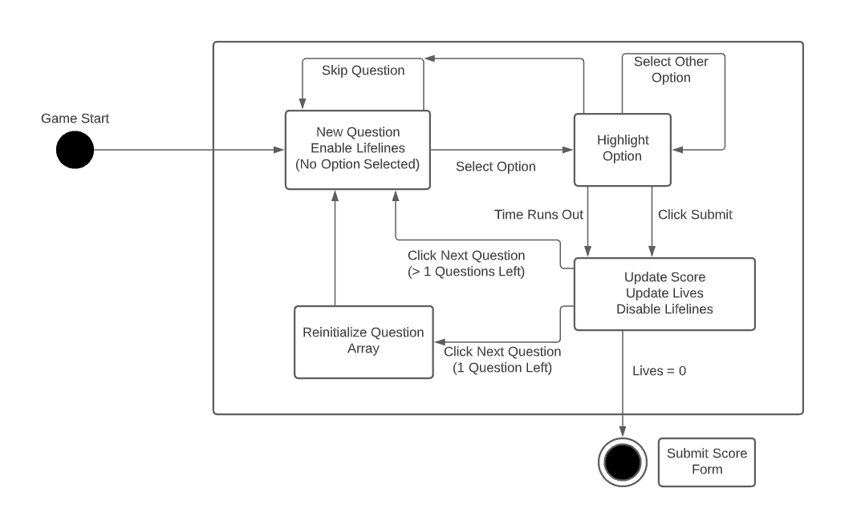
Game State Transition Diagram

Slide 14
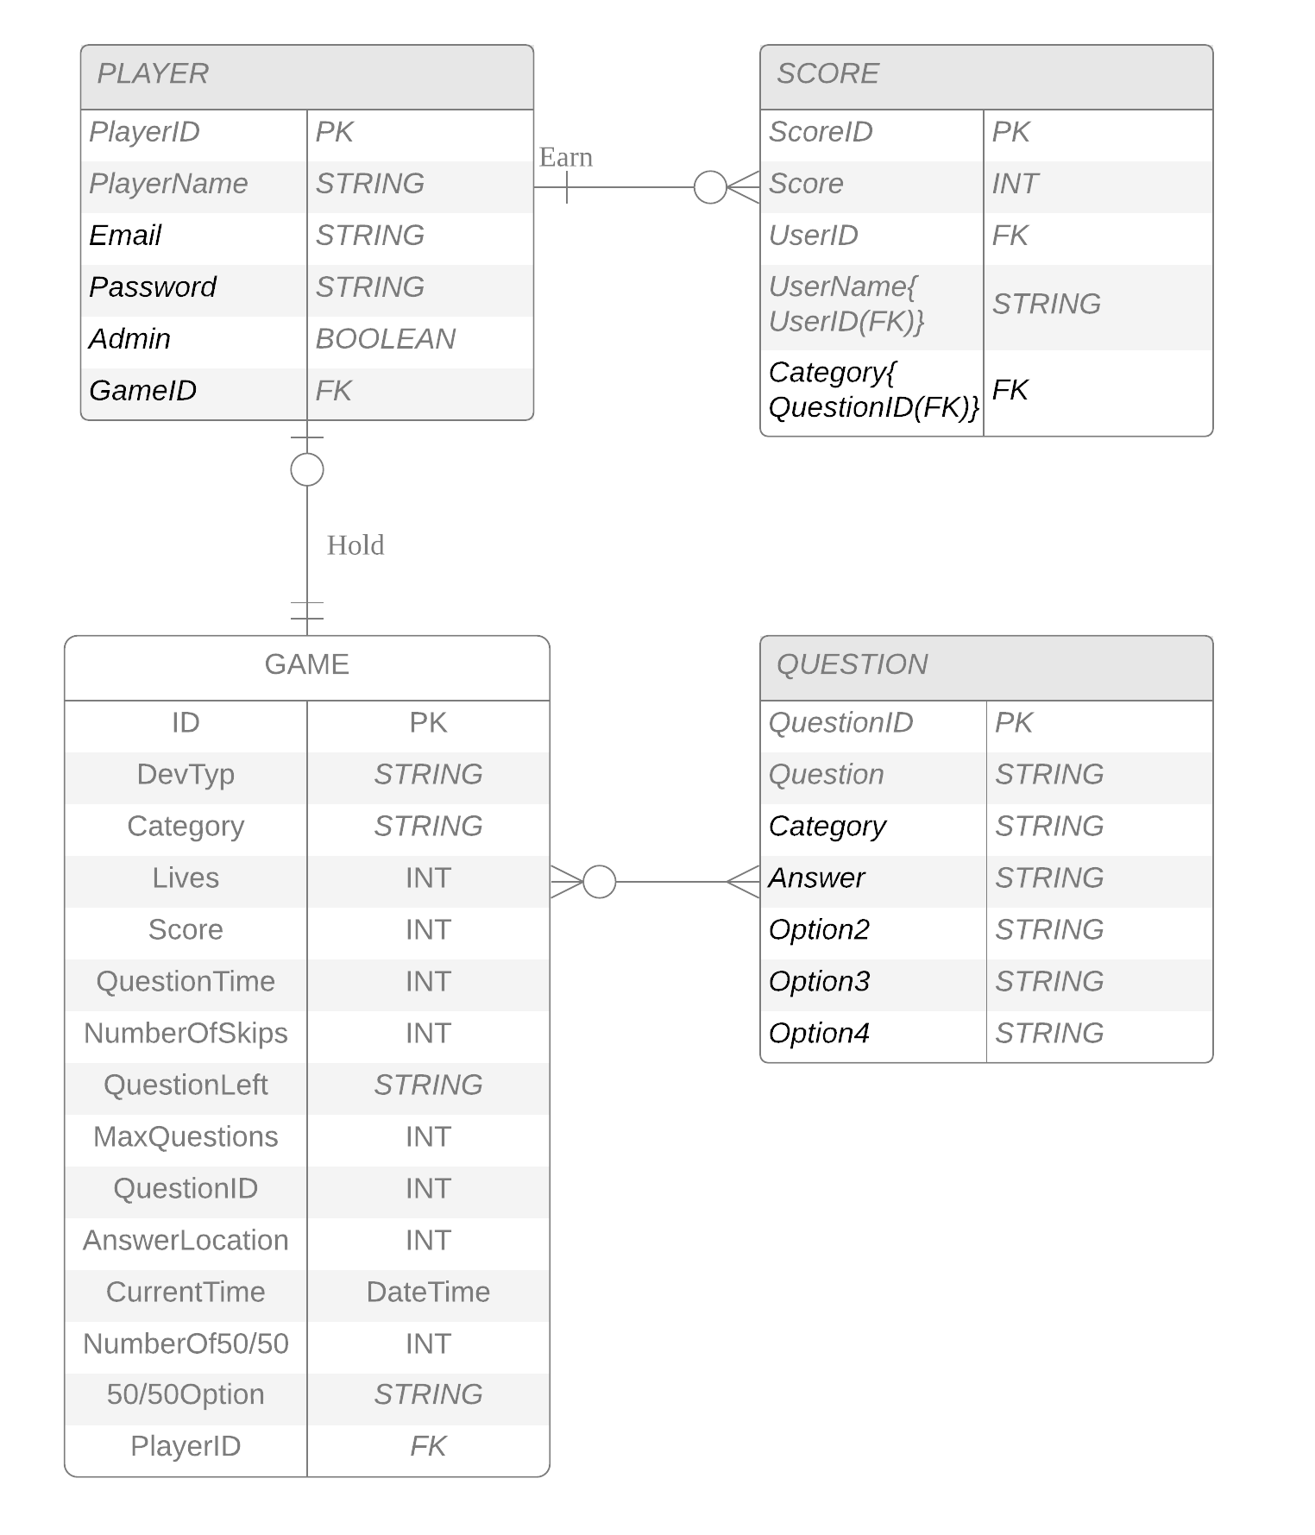
Database ERD
Player table hold player information
Player profile, Superuser, Game session, Leaderboard
Game table hold each game play
Game session
Score table hold scores are submitted
Player profile, Superuser, Leaderboard
Question table hold all questions
Game session, Superuser

Slide 15

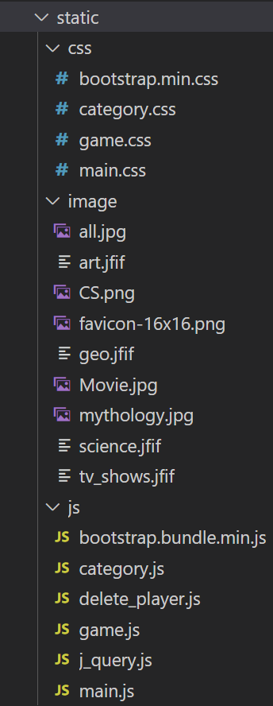

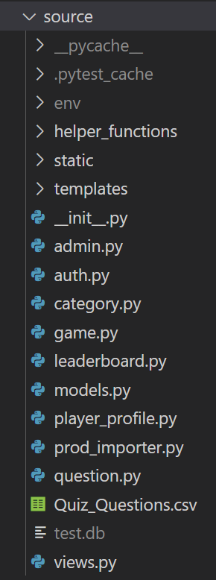


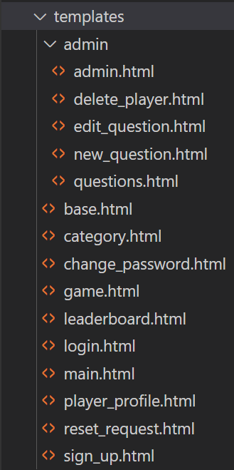
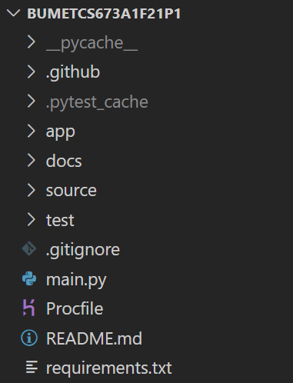

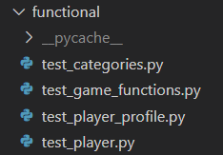

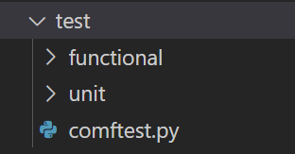

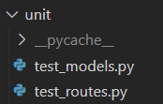
Implementation
Folder Structure:
/
/source
/source/static
/source/templates
/test
/test/functional
/test/unit

Slide 16
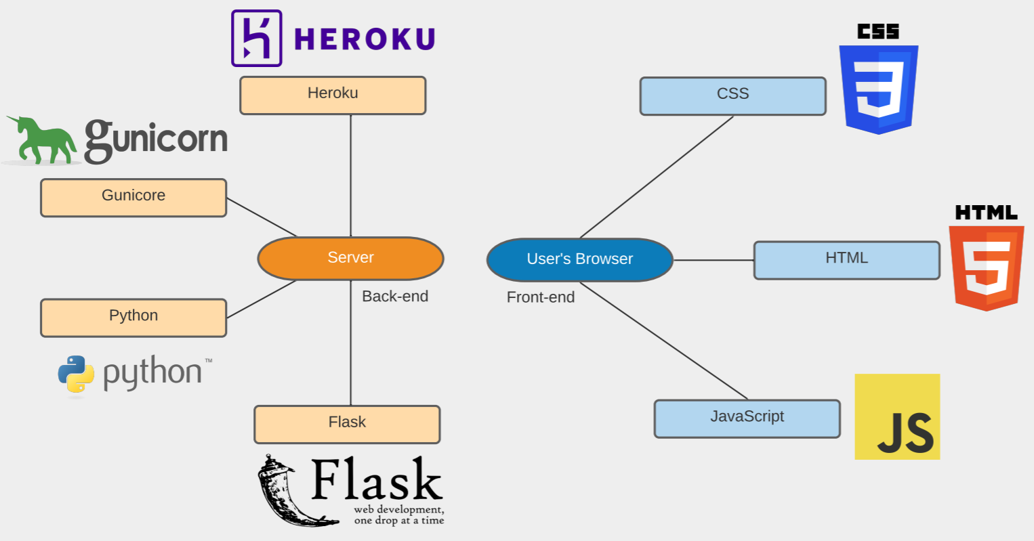
The Technical Stack

Slide 17
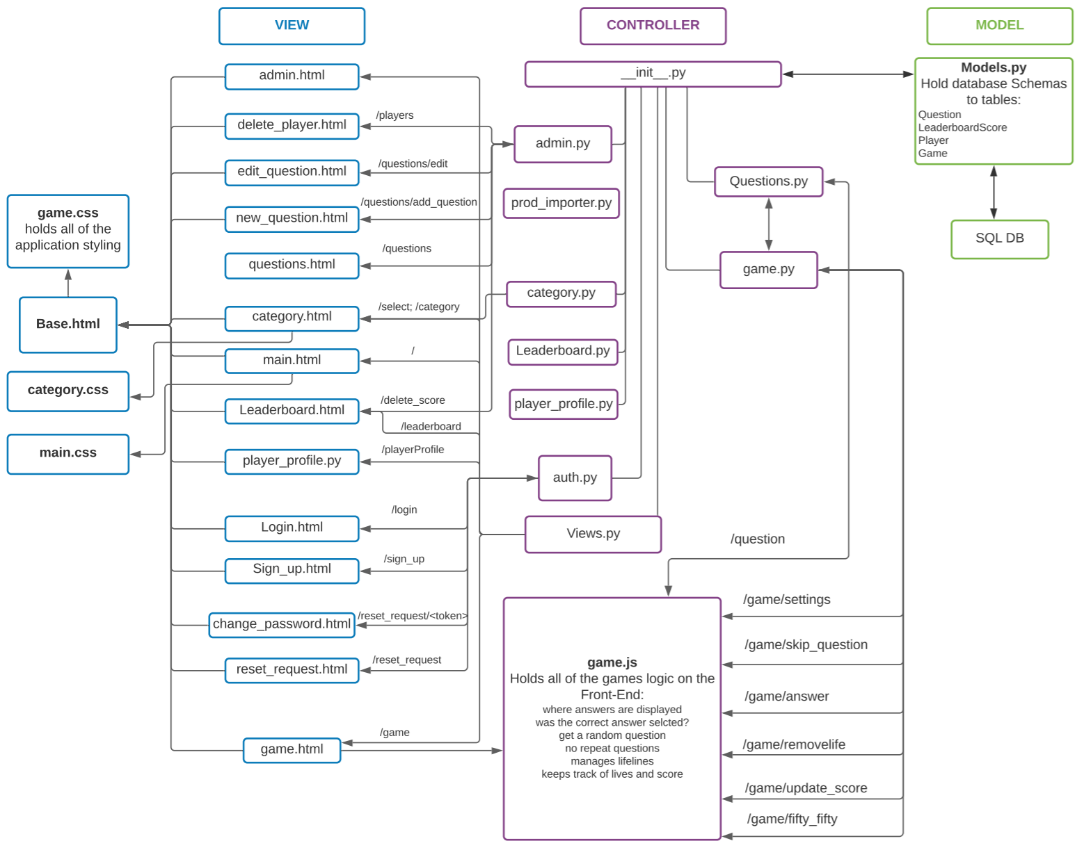
Logic Refactoring

Slide 18
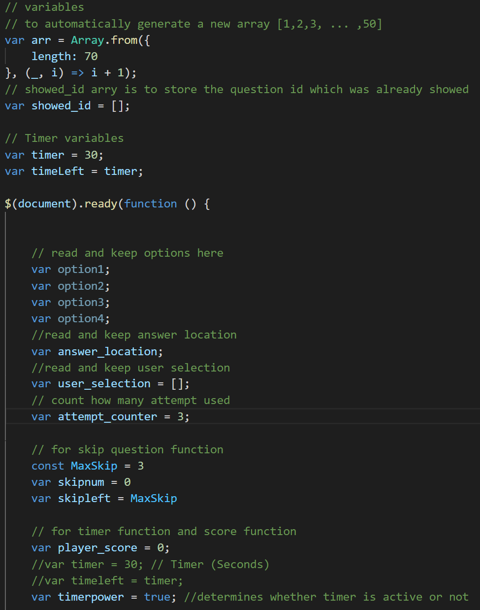
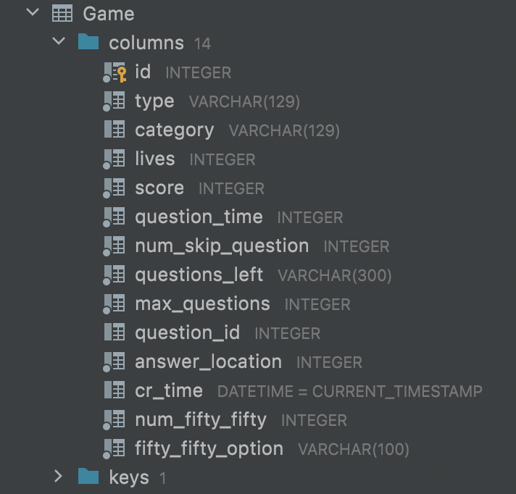
Variable Refactoring
[Iter1] The sample of variables in game.js
[Iter3] The sample of variables in db.model
First version
Third version

Slide 19
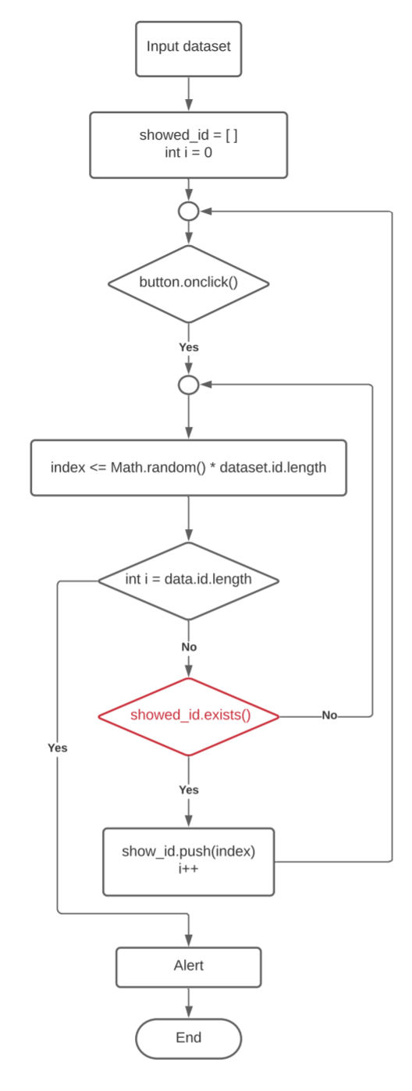
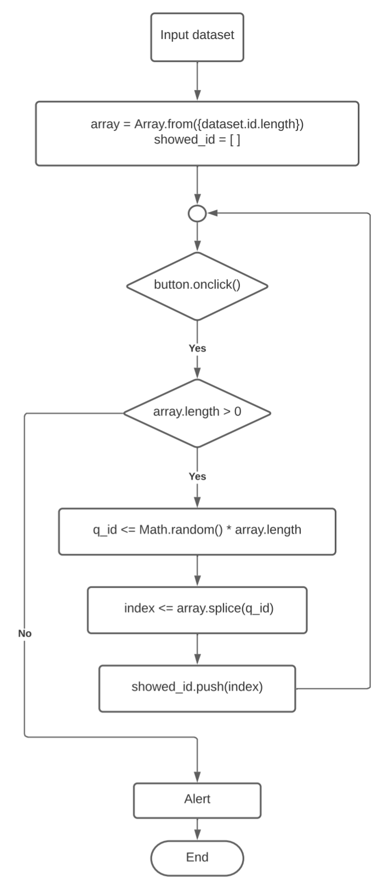
Key Algorithms
No duplicated questions
Advantage:
Easy to figure out and implement
Disadvantage:
Have more and more random id of question are “fail to be chosen” with the usage of id
Advantage:
Never fail to find and use the question id.
Disadvantage:
Splice method will change the original array
First version
Second version

Slide 20
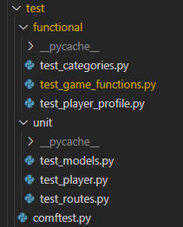
Testing Framework and Scope
Framework
Pytest is utilized for automated testing
Selenium is utilized for browser driven automated testing
Manual tests are utilized for important features for which testing wasn’t automated
Scope
Pytest: 15 distinct automatic unit / feature tests
Models (4), Routes (4), Account Management (5), Game Initialization (2)
Selenium: browser driven test for critical game features
Manual: Question Cycling, Submit Score, Password Reset and Admin Features

Slide 21
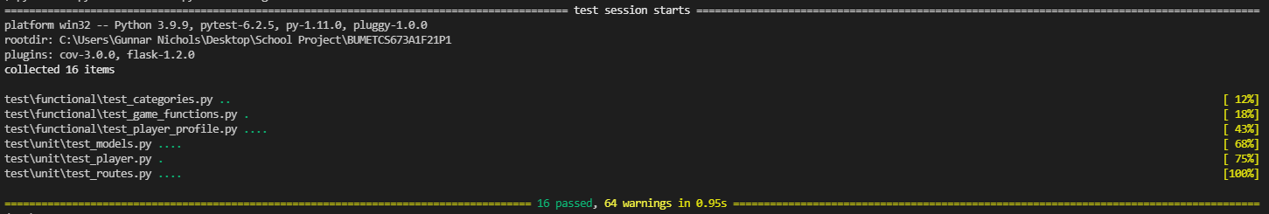
Pytest: Models, Routes, Users and Game Initialization
Models:
Question, Player,
Game and Leaderboard Models
Routes:
Home, Category,
Leaderboard and Game Pages
Account Features:
Create New User, No Duplicate Email,
Edit Email, Edit User, and Edit Password
Game Initialization:
Game Variables Load Properly
Category can be selected

Slide 22

Selenium: Game Features
Game features are tested with Selenium
The application utilizes the browser’s cache to get the game ID associated with the user to call state modifying functions
This is incompatible with test_client in Flask

Slide 23
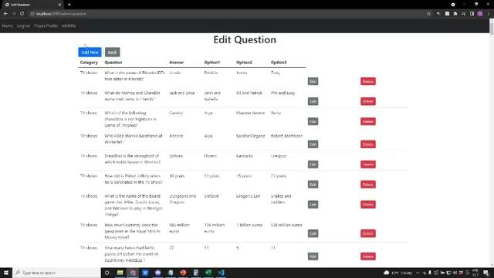
Manual: Question Reset / Submit Score / Admin Features
Features Tested manually were not possible to test automatically because:
Question Answer Location makes game state non-deterministic
HTML for Admin features wasn’t easy to automate with Selenium

Slide 24
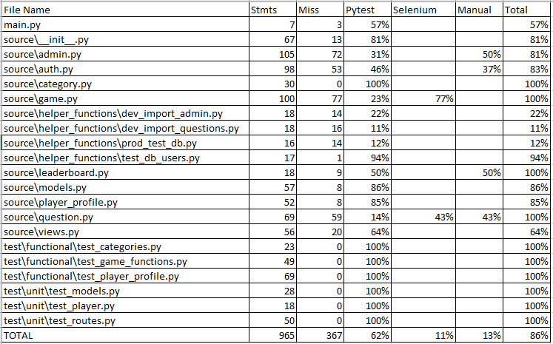
Testing Coverage
Since Flask’s ‘test-client’ couldn’t be synced with Selenium’s webdriver in the pytest framework that coverage isn’t part of pytest’s automatic report
Notes:
From looking over previous groups work, Selenium can be synced up with an automated coverage report, but this was accomplished with Flask-Testing and not pytest.

Slide 25
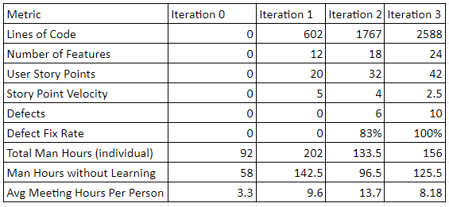
Project Metrics (By Iteration)
Total Project Hours: 771.75
Without meetings/learning: 442
*Iteration3 hours aren’t yet final

Slide 26
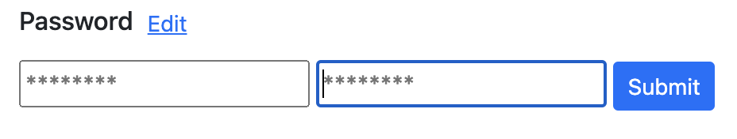
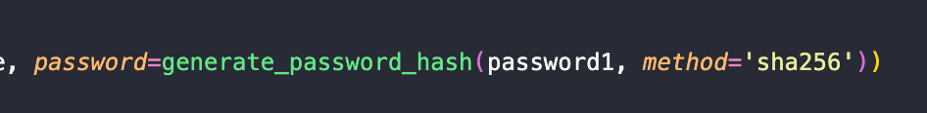
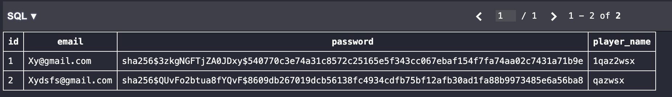
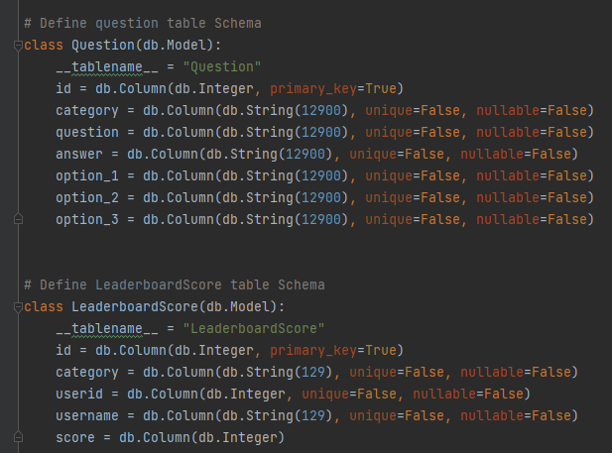
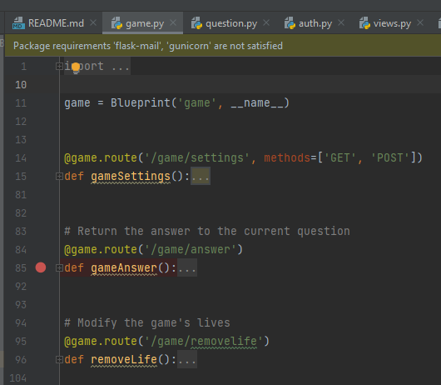
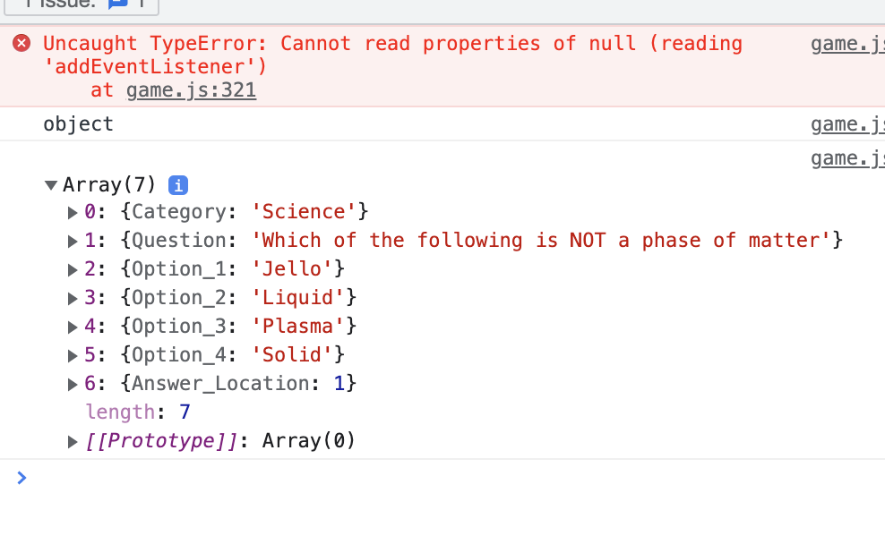
Security
Password hash
Game variables on backend
No More Answer Peeking!

Slide 27
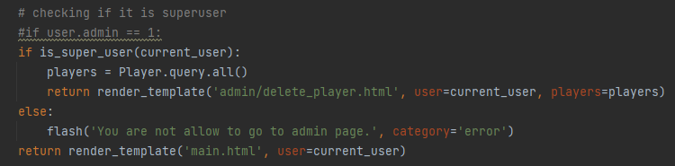

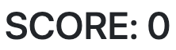
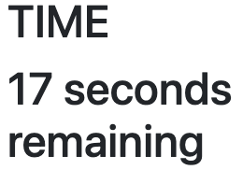
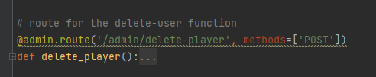
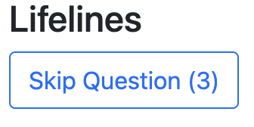
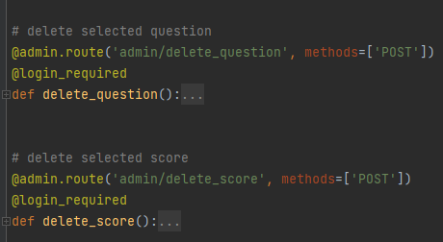
Security
Superuser set up manually on production
Solutions to previous concerns:
Frontend
Backend
Player-end:
game.js
Server-end:
models.py
Updates via the current value of the backend variable
Holds variables only changed by backend functions

Slide 28
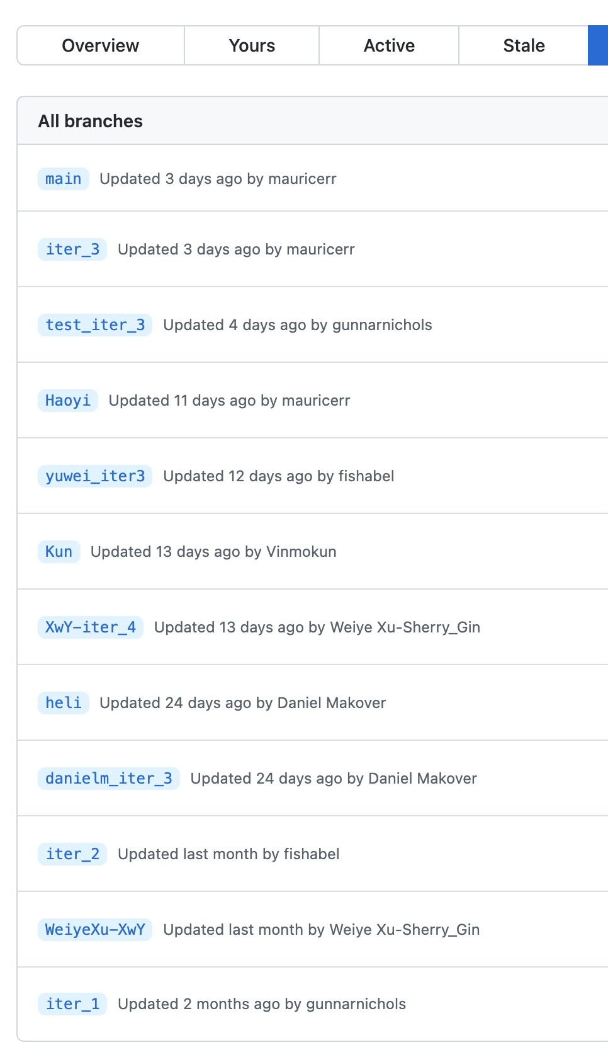
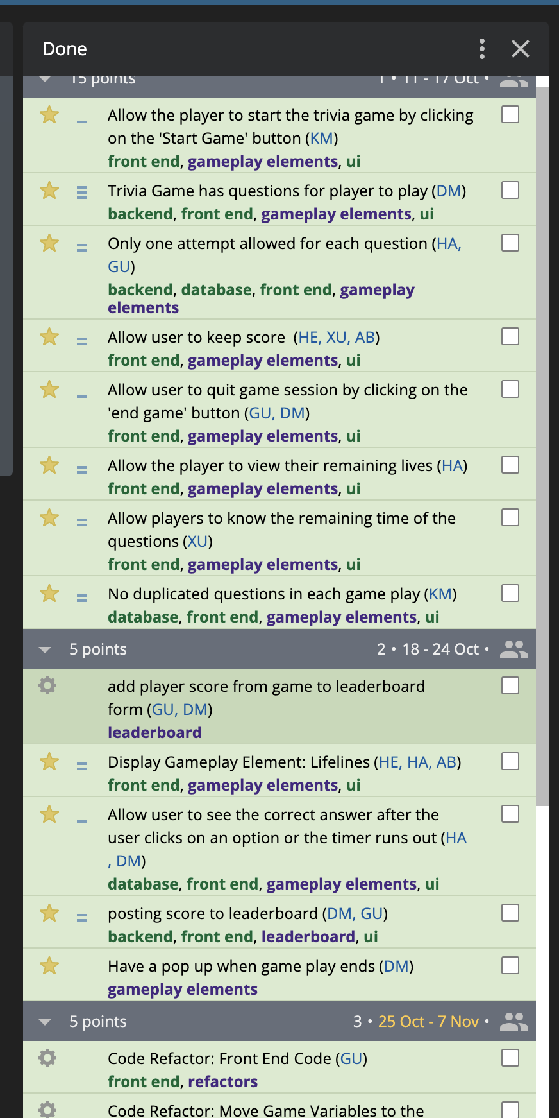
Configuration
Github
Assign task through pivotaltracker
Create a branch and start coding
Commit & push
Notice everyone in Slack after finish
Peer Testing.
Merge
Notes:
Use the github to manage the group project development,
Discuss and assign task though pivotal tracker.
After we finish discussion and assign task.
Each of us have a own branch for development.

Slide 29
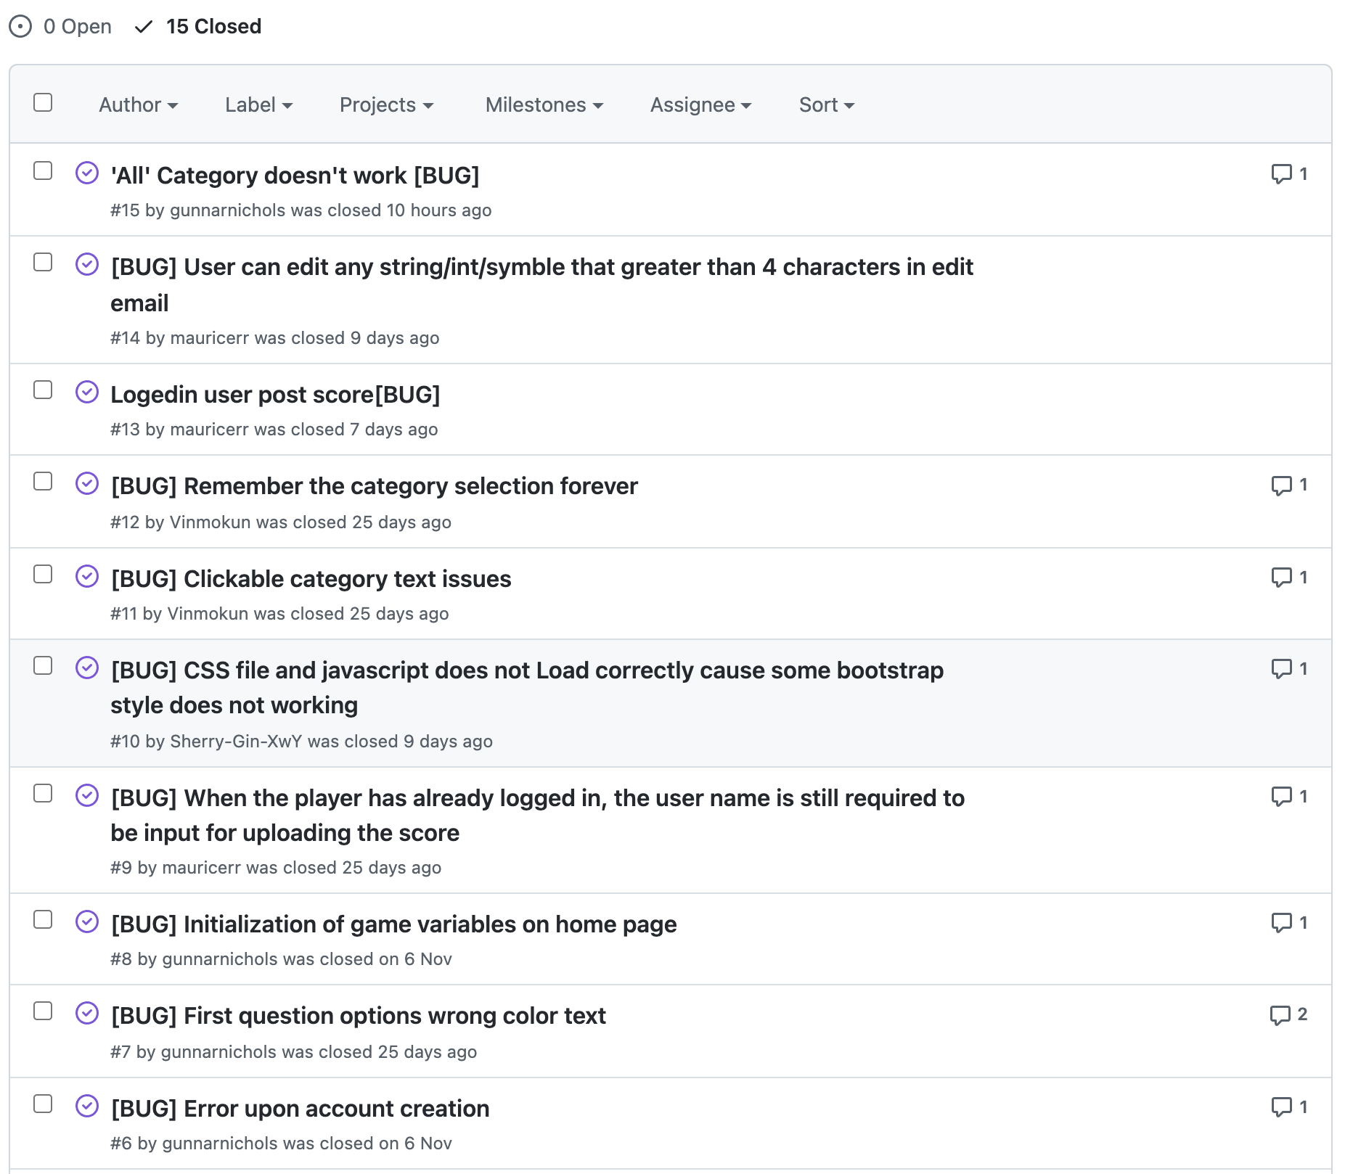
Configuration
Peer Testing
Found issues and report on the Github.
Describe and Classify the bug
Steps to reproduce the behaviour
Expected bugs behavior
Screenshots
Additional context
Discuss and fix
Done and Close
Notes:
List of libraries used in requirements.txt
Mention that we utilized github
Production / development branches
Also used for issue report in github post some bugs

Slide 30
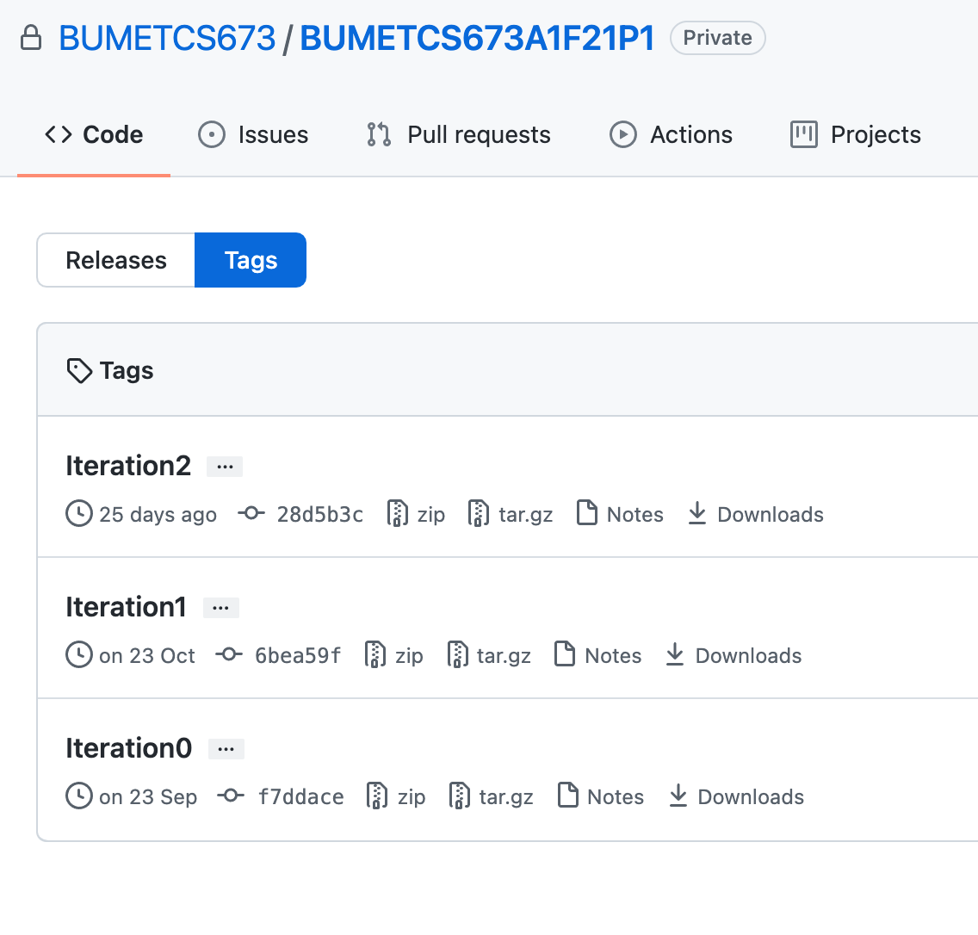
Configuration
Tags each iteration ready for release.
Source code and document

Slide 31
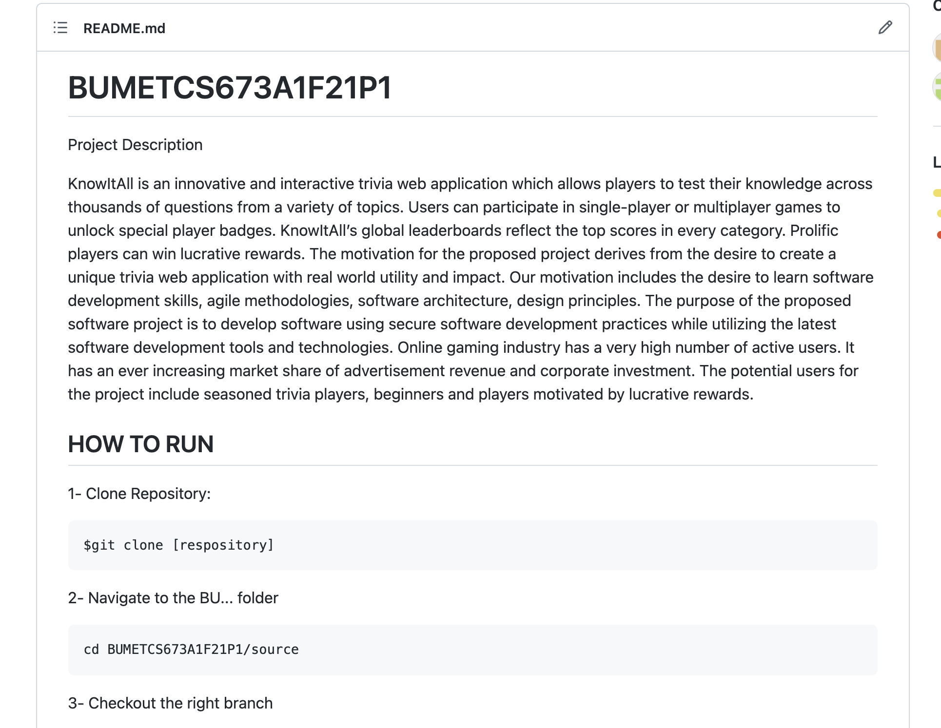
Configuration
README.md file
Description about the project
How to Run

Slide 32
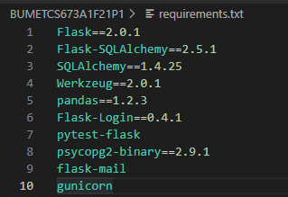
Configuration
Requirement file.txt
libraries use for our project:
Flask - Project Framework
Flask- / SQLAlchemy - Database ORM
Werkzeug - Password Encryption
Pandas - Dataframe for Production DB
Flask-Login - User Login
Pytest / -flask - Testing Framework
Psycopg2-binary
Flask-mail - Password Resetting
Gunicorn - Production Server

Slide 33


Deployment
The application was deployed to Heroku for production
CODE: All files and modules are copied over to the production server
DATABASE: PostgreSQL Database is used in place of SQLite
*ISSUES: PostgreSQL queries are more strict than SQLite. Doesn’t work as well with ORM SQLALCHEMY *
To differentiate between Development and Production configurations we had a variable called ENV in the start of the application which would be referenced throughout the app to determine which flow of logic to use.

Slide 34
Group Management
At the beginning of Iteration 0:
We meet once a week on Saturday with an optional meeting Monday - Thursday
Planning focused on implementing features
Towards the end of Iteration 3:
Meetings 4 times a week. Saturday, Monday, Wednesday, and Thursday( after class)
Planning focused on a mix of features, refactors, and testing
As the application become more complex our management and implementation became more agile to account for new insight on the development lifecycle.

Slide 35
Risk Management (Past vs Present)
Risks at iteration 0
Not familiar with the framework used (Team members can't contribute work due to lack of programing framework know-how)
Lack of motivation or responsibility (required work is not completed)
Useless work (unnecessary work)
Risks at iteration 3
Difference in Production environment (New need to modify code to work in Production)
Branch Management (team members end up doing extra work since)
Overplanning (team members devote time to a feature that ends up getting cut due to constraints)

Slide 36
Iteration 4 - What would we add?
Daniel - Refactor code to scale better with testing
Gunnar - Expand testing be compatible to work with the production stack
Kun - Try to refactor the code with more official design patterns
Yuwei - Player profile page upgrade, google login api
Weiye - Add some effect, like sound effect, some interesting 3D style.
Haoyi - Refactor 50/50 lifeline function, with better algorithm.
Heli- User Feedback and Ratings

Slide 37
What we learned?
Daniel - Branch Management is key to having a smooth implementation. Make your Development and Production Environments as similar as possible.
Gunnar - Communication and coordination is the hard part of producing software
Kun - As a team, a good code organization and configuration can help us clearly to know what they are and what should be done.
Yuwei - Almost everything I’ve done in this project.
Weiye - how does a process of software development looks like. And how to use some software, like github and pivotal tracker during the development. Development though Flask.
Haoyi- Flask related skill is new for me, also the agile development team work.
Heli- Software development skills and team management skills

Slide 38
QUESTIONS?

Slide 39
ASK STUDENTS TO PLAY THE GAME
https://cs673-knowitall-3.herokuapp.com/

